Slide 1
距离向量路由算法

Slide 2
Distance Vector Algorithm
Bellman-Ford Equation (dynamic programming)
Define
d_{x}(y) := cost of least-cost path from x to y
Then
d_{x}(y) = min {c(x,v) + d_{v}(y) }
where min is taken over all neighbors v of x

Slide 3
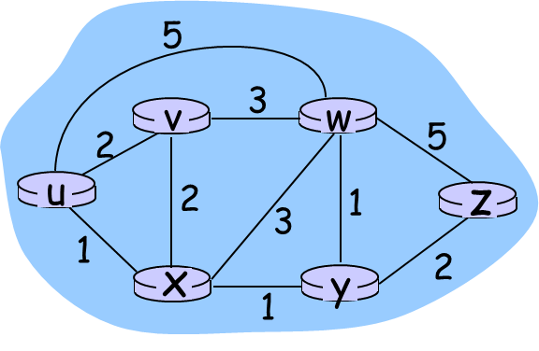
Bellman-Ford example
Clearly, d_{v}(z) = 5, d_{x}(z) = 3, d_{w}(z) = 3
B-F equation says:
d_{u}(z) = min { c(u,v) + d_{v}(z),
c(u,x) + d_{x}(z),
c(u,w) + d_{w}(z) }
= min {2 + 5,
1 + 3,
5 + 3} = 4
Node that achieves minimum is next
hop in shortest path ➜ forwarding table

Slide 4
Distance Vector Algorithm
D_{x}(y) = estimate of least cost from x to y
Node x knows cost to each neighbor v: c(x,v)
Node x maintains distance vector D_{x} = [D_{x}(y): y є N ]
Node x also maintains its neighbors’ distance vectors
For each neighbor v, x maintains D_{v} = [D_{v}(y): y є N ]

Slide 5
Distance vector algorithm
Basic idea:
From time-to-time, each node sends its own distance vector estimate to neighbors
Asynchronous
When a node x receives new DV estimate from neighbor, it updates its own DV using B-F equation:
D_{x}(y) ← min_{v}{c(x,v) + D_{v}(y)} for each node y ∊ N
Under minor, natural conditions, the estimate D_{x}(y) converge to the actual least cost d_{x}(y)

Slide 6
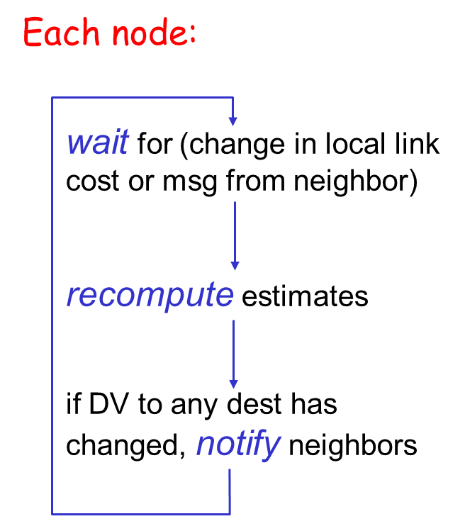
Distance Vector Algorithm
Iterative, asynchronous: each local iteration caused by:
local link cost change
DV update message from neighbor
Distributed:
each node notifies neighbors only when its DV changes
neighbors then notify their neighbors if necessary

Slide 7
D_{x}(y) = min{c(x,y) + D_{y}(y), c(x,z) + D_{z}(y)} = min{2+0 , 7+1} = 2
D_{x}(z) = min{c(x,y) + D_{y}(z), c(x,z) + D_{z}(z)}
= min{2+1 , 7+0} = 3
node x table
cost to
cost to
x y z
x y z
x
0 2 7
x
0
2
3
y
from
from
∞
∞
∞
y
2 0 1
z
∞
∞
∞
z
7 1 0
node y table
cost to
x y z
y
2
1
x
∞
∞
z
∞
2 0 1
x
y
7
from
z
∞
∞
∞
node z table
cost to
x y z
x
∞ ∞ ∞
from
y
∞
∞
∞
z
7
1
0
time

Slide 8
D_{x}(y) = min{c(x,y) + D_{y}(y), c(x,z) + D_{z}(y)} = min{2+0 , 7+1} = 2
D_{x}(z) = min{c(x,y) + D_{y}(z), c(x,z) + D_{z}(z)}
= min{2+1 , 7+0} = 3
node x table
cost to
cost to
cost to
x y z
x y z
x y z
x
0 2 7
x
0 2 3
x
0 2 3
y
from
from
∞
∞
∞
y
2 0 1
from
y
2 0 1
z
∞
∞
∞
z
7 1 0
z
3 1 0
node y table
cost to
cost to
cost to
x y z
x y z
x y z
y
2
1
x
∞
∞
x
0 2 7
x
0 2 3
z
∞
2 0 1
x
y
from
from
y
2 0 1
from
7
y
2 0 1
z
∞
∞
∞
z
7 1 0
z
3 1 0
node z table
cost to
cost to
cost to
x y z
x y z
x y z
x
∞ ∞ ∞
x
0 2 7
x
0 2 3
from
from
from
y
y
2 0 1
y
∞
2 0 1
∞
∞
z
z
3 1 0
z
3 1 0
7
1
0
time

Slide 9
DV versus LS
Distance Vector
仅与邻居节点交换消息
消息包括到所有节点的最短距离
收敛速度比较慢
能够广播不正确的路径信息
有Count to Infinity Problem
Link State
向网络上所有其它节点广播消息
消息仅包括到邻居节点的距离
收敛速度比较快
能够广播不正确的链路信息
没有Count to Infinity Problem

Slide 10

Summary
Distance vector routing algorithm

